Slide 1

Introduction
22-808: Generative models Sharif University of Technology Fall 2024
Fatemeh Seyyedsalehi

Slide 2
Course info.
Lecturer: Fatemeh Seyyedsalehi
Contact: fateme.ssalehi@gmail.com
Head TA: Seyyed Reza Tavakoli
Contact: seyedreza.shiyade@gmail.com
Course website: On Quera - Github
Tentative schedule, lectures
Policies and rules
Discussions
HWs & solutions

Slide 3
Grading policy
Mid-term exam: 4
Final exam: 6
Homework (5 practical and conceptual HWs): 7.5
4 tiny quizzes: 1
Presentation: 1
Class attendance: 0.5

Slide 4
Text books and related courses
Books:
Bishop, Christopher M. and Hugh Bishop, Deep Learning: Foundations and Concepts, Springer
Murphy, Kevin P, Probabilistic Machine Learning: Advanced Topics, The MIT Press
Tomczak, Jakub M., Deep Generative Modeling, Springer
Koller D., Friedman N., Probabilistic Graphical Models, Principles and Techniques, The MIT Press
Courses with similar topics from other institutions:
Stanford CS-236: Deep Generative Models
Washington CSE-599: Generative Models
Tehran university: Deep generative models
Berkeley CS 294-158: Deep Unsupervised Learning

Slide 5
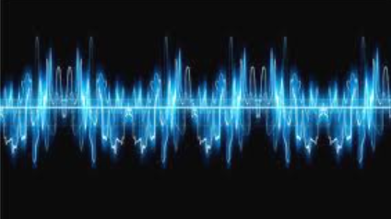
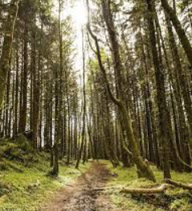
Introduction
We should understand complex and unstructured phenomenon to be able to generate them
Audio signals
Natural images
Natural languages
به نام آنکه جان را فکرت آموخت

Slide 6
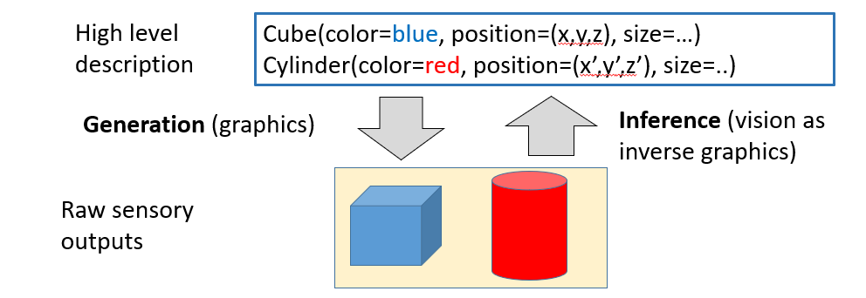
Introduction
Our tools to understand phenomenon is statistics
In contrast to rule based techniques
We use probability distributions to describe any thing
Images
Sentences
Videos
Audios
…
Ermon-Stanford-CS236

Slide 7
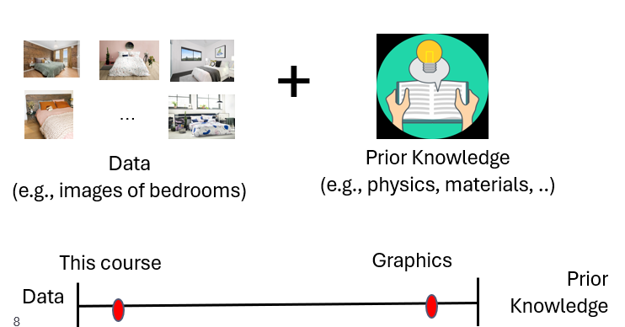
Statistical generative models
Statistical generative models are learned from data
Priors are always necessary, but there is a spectrum
Ermon-Stanford-CS236

Slide 8
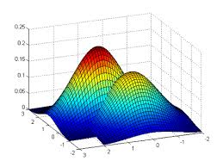
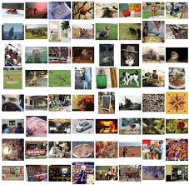
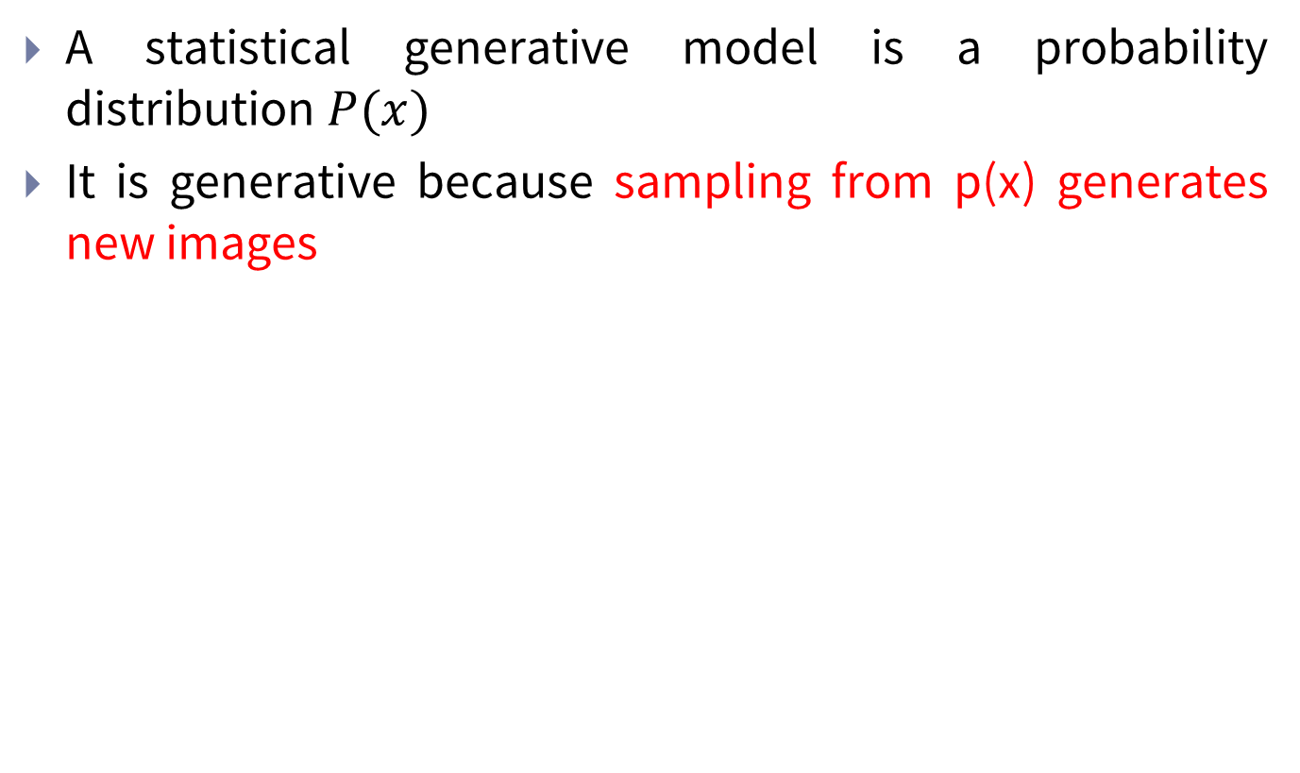
Statistical generative models
A statistical generative model is a probability distribution $P(x)$
It is generative because sampling from p(x) generates new images
$$P_{θ}(x)$$

Slide 9
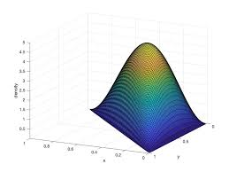
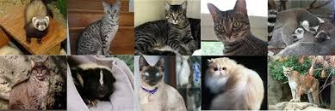
Statistical generative models
We also can control the process of generation
Conditional generative models
$$P_{θ}(x)$$
9
Control signal

Slide 10
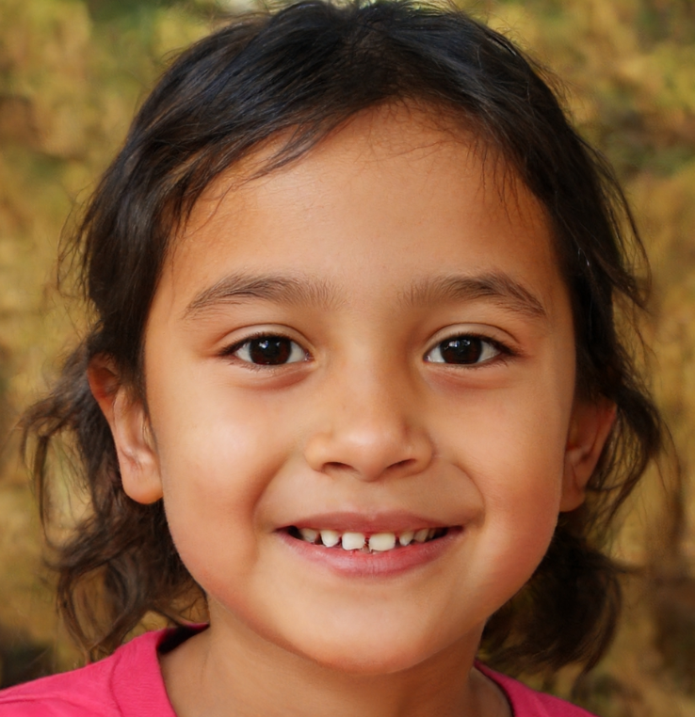
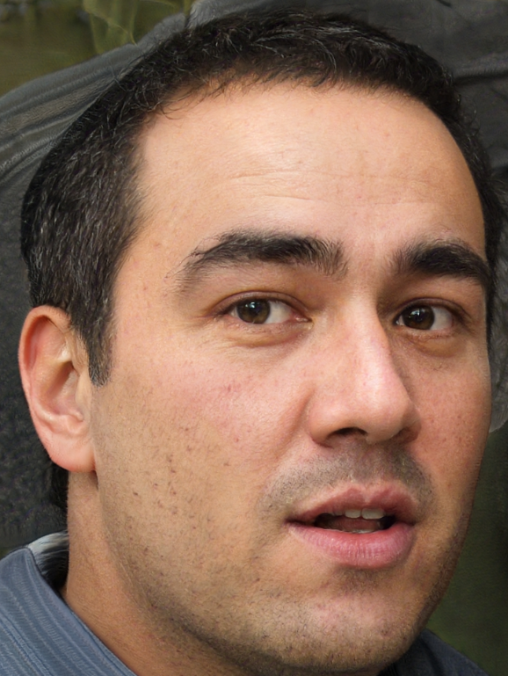
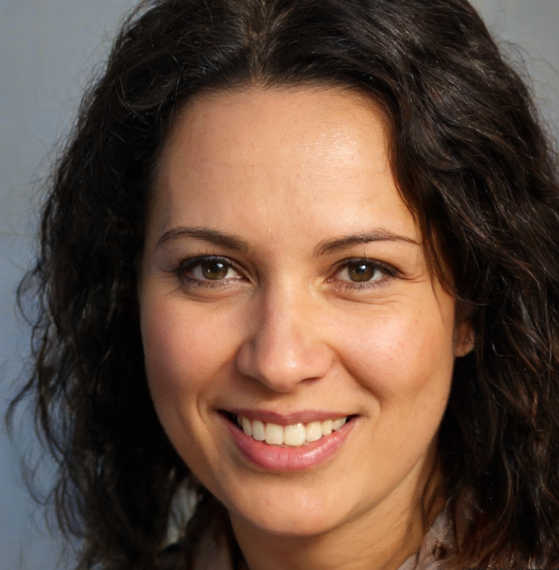
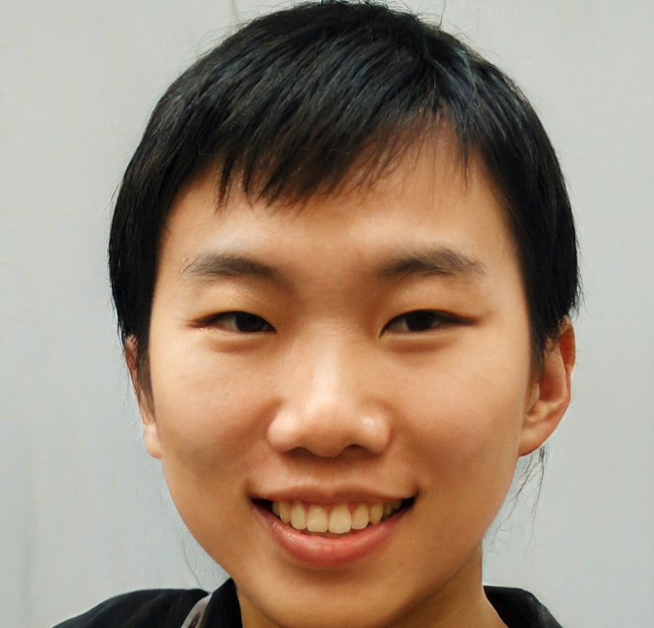
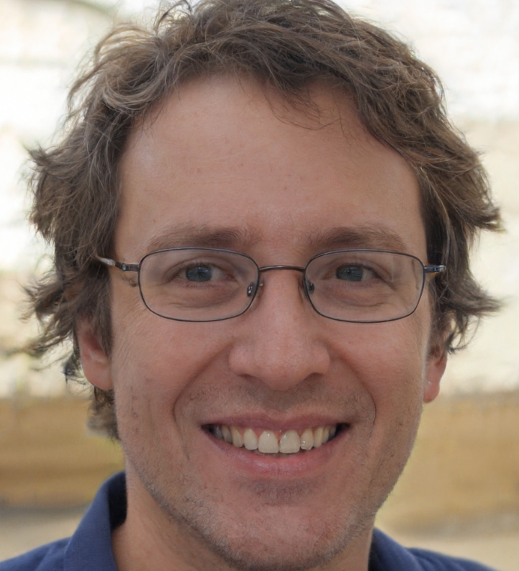
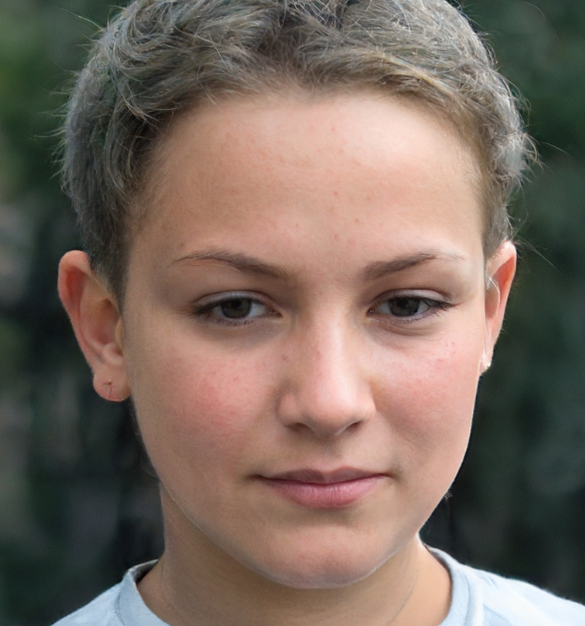
Generative model examples Image generation
This person does not exist!
https://thispersondoesnotexist.com/
10

Slide 11
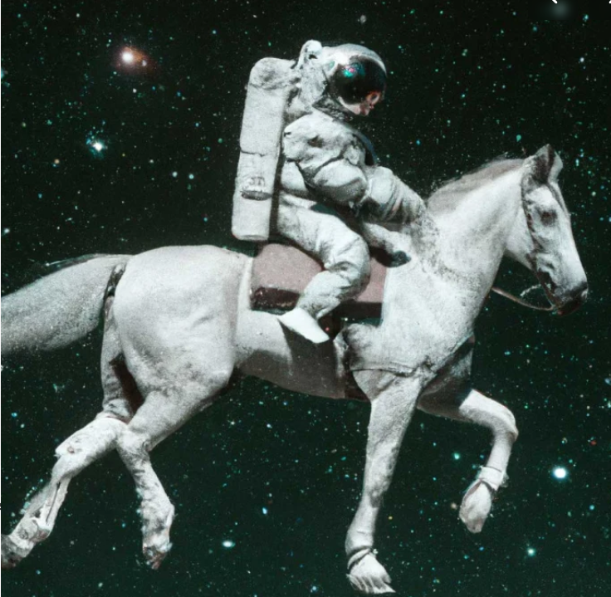
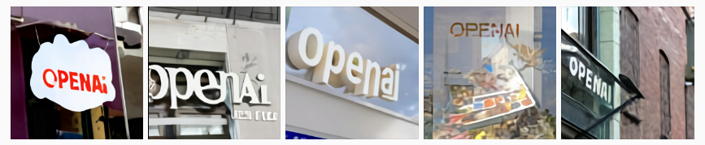
Generative model examples Image generation
OpenAI Dall-E
https://openai.com/index/dall-e/
Prompt: “A photorealistic image of an
astronaut riding a horse”
Prompt: "A store front that has the word ‘OpenAI’ written on it”

Slide 12
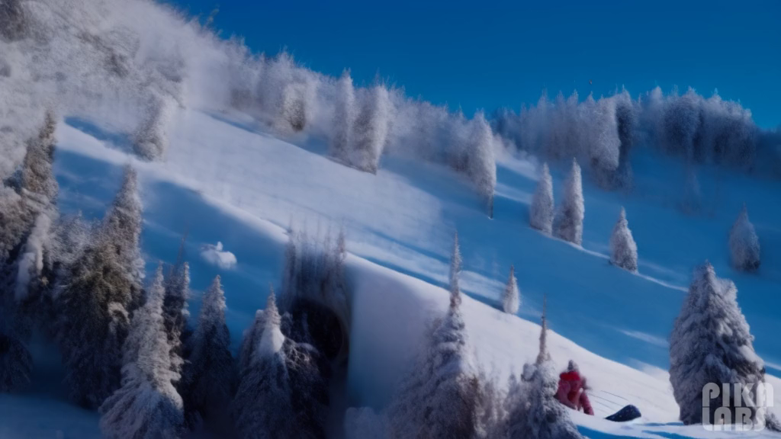

Generative model examples Video generation
Prompt: “A couple sledding down a snowy hill on a tire roman chariot style”
Prompt: “Suddenly, the walls of the embankment broke and there was a huge flood”

Slide 13
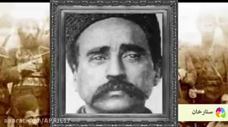
Generative model examples Video generation
Deepfake
https://deepfakesweb.com/projects

Slide 14
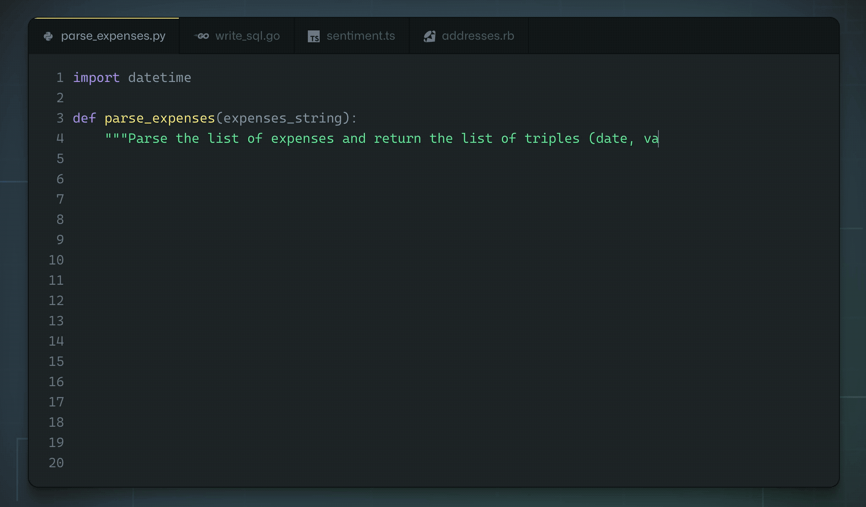
Generative model examples Code generation
OpenAI Codex
https://openai.com/index/openai-codex/

Slide 15

Generative model examples Language generation
OpenAI ChatGPT
https://openai.com/chatgpt/

Slide 16

Generative model examples Speech generation
مدل متن به گفتار فارسی
"برای موفقیت در درس یادگیری مولد، حضور در کلاس، مطالعه فردی و انجام به موقع تمرینات لازم است. این حوزه امروزه یکی از موضوعات به روز هم در دنیای تحقیقات و هم در حوزه صنعت به شمار می رود."

Slide 17
Foundation models
The term of foundation model describes large ML models trained on a broad spectrum of generalized and unlabeled data
The ability of performing a wide variety of general tasks such as understanding language, generating text and images, and conversing in natural language
They changed the way data scientists approach machine learning
Rather than developing from scratch, a foundation model can be used as a starting point to develop ML models that power new applications more quickly and cost-effectively.
A good paper:
“On the Opportunities and Risks of Foundation Models”

Slide 18
Course overview
(Probabilistic graphical models) Directed (Bayesian networks) and undirected (Markov random fields))
Exact and approximate inference - Learning from complete and incomplete data
Causality and causal inference
(Deep generative models) Autoregressive Models
The NADE Framework
Text modeling, LSTM and Transformers, Intro. to large language models
Variational Autoencoders
The Gaussian VAE
Generative Adversarial Nets
f-GANs & Wasserstein GANs
Generative Flow
Invertible Networks
Neural Ordinary Differential Equations
Energy-Based Models
Stein's Method and Score Matching
Langevin Dynamics and Diffusions
Evaluation and Trustworthy generative AI

Slide 19
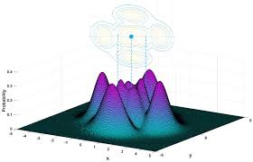
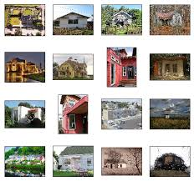
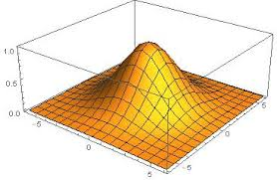
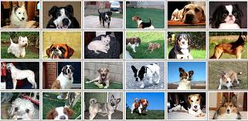
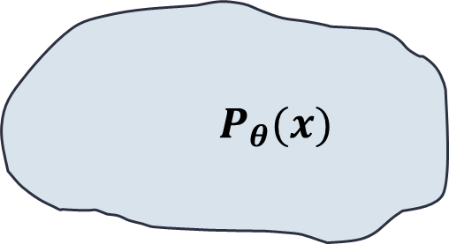
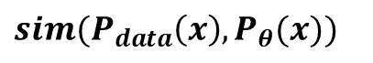
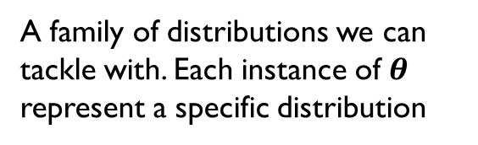
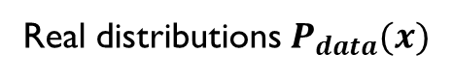
The generation problem
A family of distributions we can tackle with. Each instance of $θ$ represent a specific distribution
$$P_{θ}(x)$$
$$sim(P_{data}\left(x\right), P_{θ}(x))$$
Searching the model family
with a similarity metric
19
Real distributions $P_{data}(x)$

Slide 20
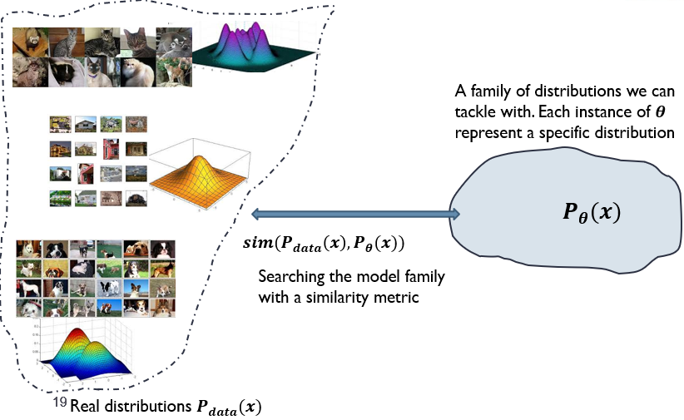
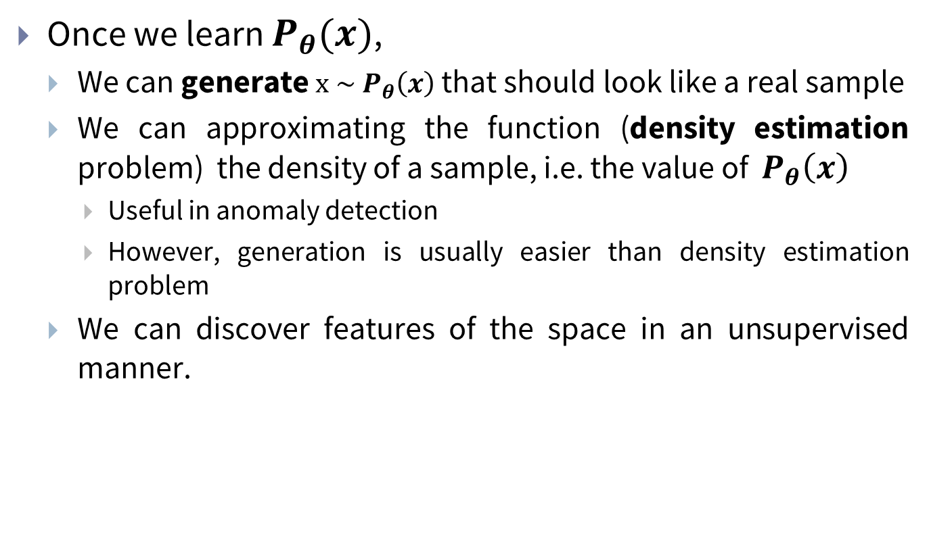
The generation problem
Once we learn $P_{θ}(x)$,
We can generate $x \sim P_{θ}\left(x\right)$ that should look like a real sample
We can approximating the function (density estimation problem) the density of a sample, i.e. the value of $P_{θ}\left(x\right)$
Useful in anomaly detection
However, generation is usually easier than density estimation problem
We can discover features of the space in an unsupervised manner.

Slide 21
Representation of model space
We should represent distribution spaces in a way we could tackle with
Optimization, generation, density estimation, inference, …
Our approaches
Basic parametric distributions
Probabilistic graphical models
Deep neural networks
Restricting to a parametric family of functions regularizes the problem.

Slide 22
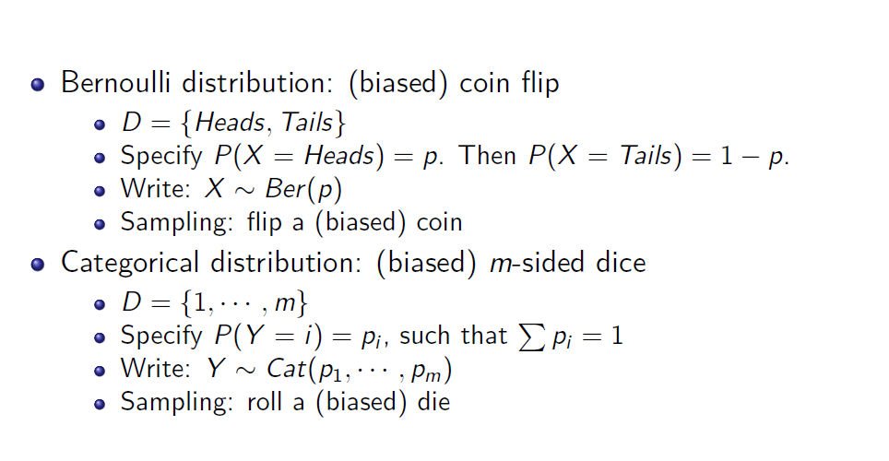
Representation of model space
Ermon-Stanford-CS236

Slide 23
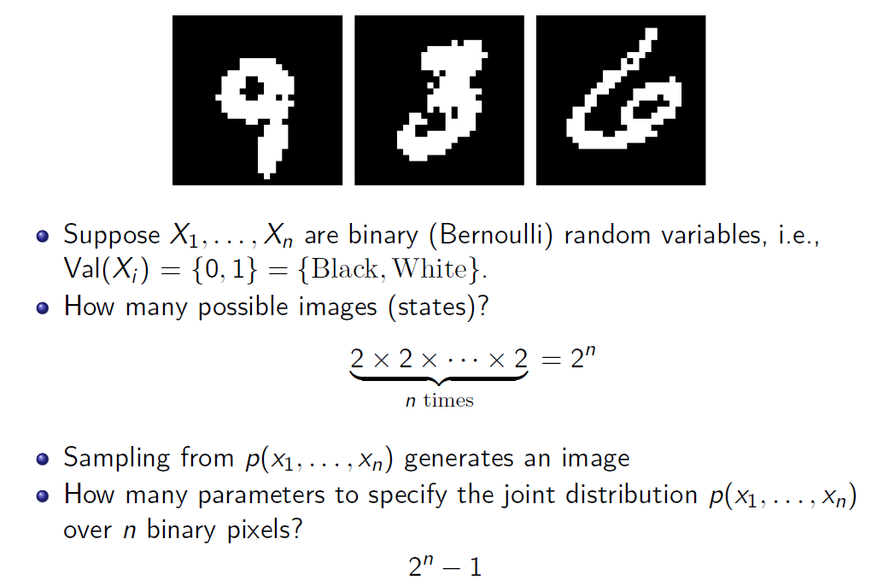
Representation of model space
Ermon-Stanford-CS236

Slide 24
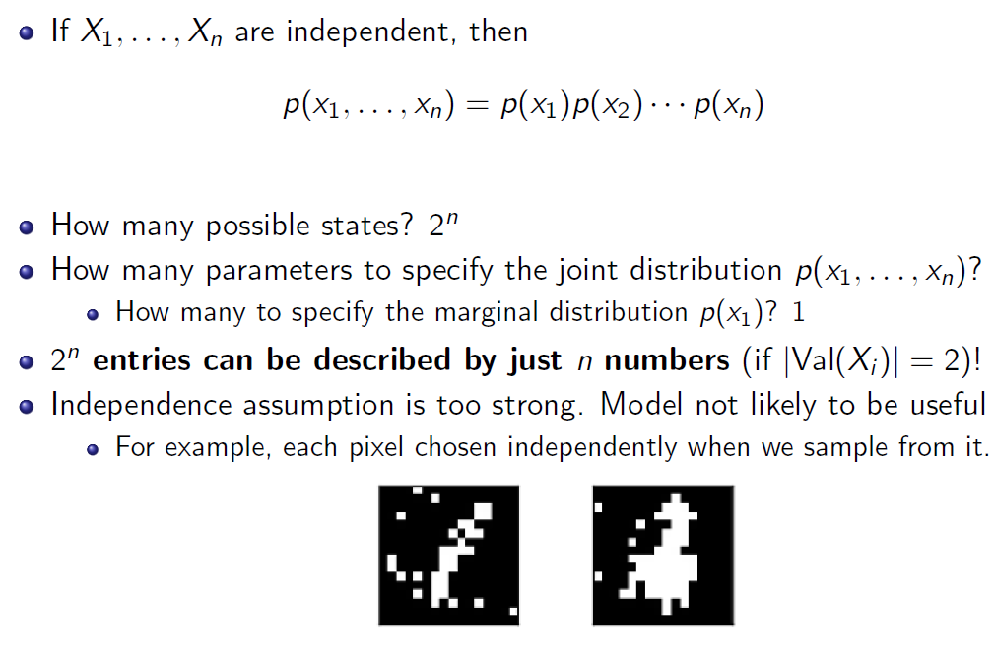
Representation of model space
Ermon-Stanford-CS236

Slide 25
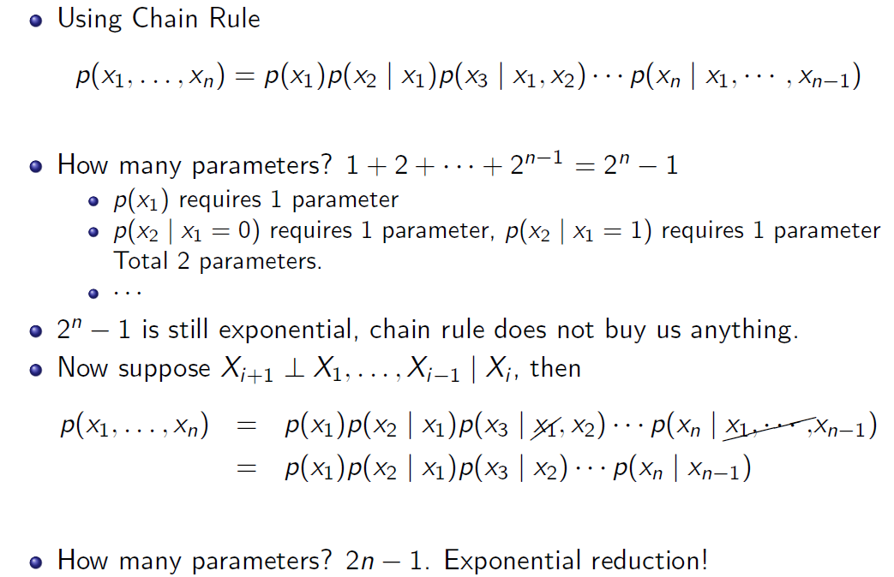
Representation of model space
Ermon-Stanford-CS236

Slide 26
Representation of model space
By factorizing joint distributions with independency assumption,
We assume a structure for the problem domain
We regularize the problem
We simplify the hypothesis (distributions) space
Probabilistic graphical models
A way to represent a factorized joint distribution over as system of random variables with independency assumptions
We will introduce them first
Deep neural network
More complicated and descriptive tool for representation of a model family.

Slide 27
Next Session
Probabilistic graphical models
Directed (Bayesian networks)
Undirected (Markov random fields)

